Slide 1
The Trig River
Sara Popow
Notes:
Rippling Water
(Basic)
Note: This video template is optimized for Microsoft PowerPoint 2010.
In PowerPoint 2007, video elements will play, but any content overlapping the video bars will be covered by the video when in slideshow mode.
In PowerPoint 2003, video will not play, but the poster frame of the videos will remain in place as static images.
The video:
Plays automatically after each slide transition.
Is 15 seconds long.
Seamlessly loops for infinite playback.
To add slides or change layout:
To add a new slide, on the Home tab, in the Slides group, click the arrow under New Slide, then click under Motion Background Theme, then select the desired layout.
To change the layout of an existing slide, on the Home tab, in the Slides group, click Layout, then select the desired layout.
Other animated elements:
Any animated element you insert will begin after the slide transition and the background video has started.
Layouts with video effects:
The “(Green) Title and Content” and “(Purple) Title and Content” layouts are creating by using a color overlay on the video.
With the video selected, under Video Tools, on the Format tab, in the Adjust group, select Color and choose Teal, Accent Color 6 Light (third row, seventh option from left) or Periwinkle, Accent Color 5 Light (third row, sixth option from left).

Slide 2
Common Core Standards
Mathematical Practices
1. Make sense of problems and persevere in solving them.
2. Reason abstractly and quantitatively.
4. Model with mathematics.
5. Use appropriate tools strategically.
6. Attend to precision.
7. Look for and make use of structure.
Define trigonometric ratios and solve problems involving right triangles
6. Understand that by similarity, side ratios in right triangles are properties of the angles in the triangle, leading to definitions of trigonometric ratios for acute angles.
8. Use trigonometric ratios and the Pythagorean Theorem to solve right triangles in applied problems.

Slide 3
Introduction
Is it possible to determine the width of a river without crossing it?
Answer: It is possible to come very close to determining the width of a river of any size, using triangles.
The same principle used to determine the width of a river can be applied to other situations, including determining the height of a hill, a tree or a building. The simple geometric shape that makes this all possible is the triangle.
During this activity, you will learn how to use triangles to determine the width of a river.

Slide 4
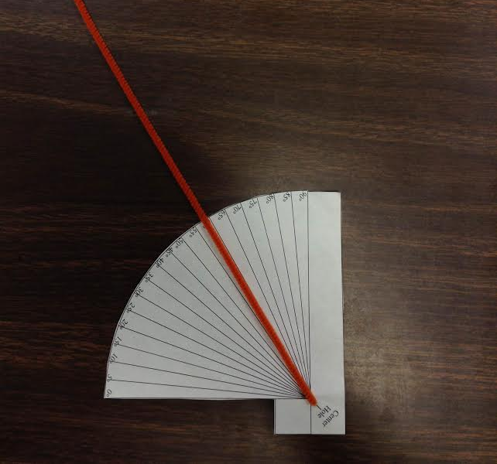
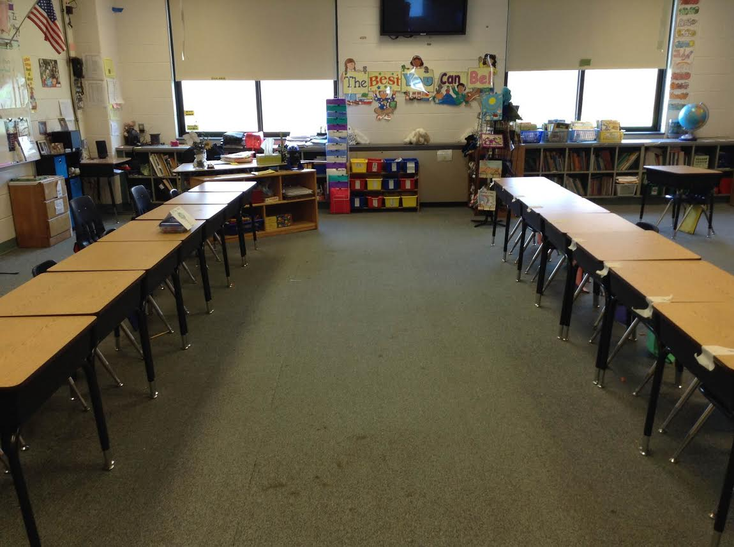
Materials
Student Trig River Worksheets
Paper Half Protractor
“River” (inside or outside)

Slide 5
Set Up

Slide 6
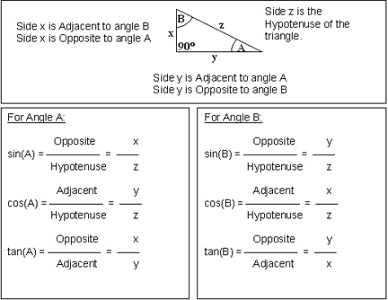
Lets Review
SOH CAH TOA
Is there a way we can apply this theorem to our problem?
YES!

Slide 7
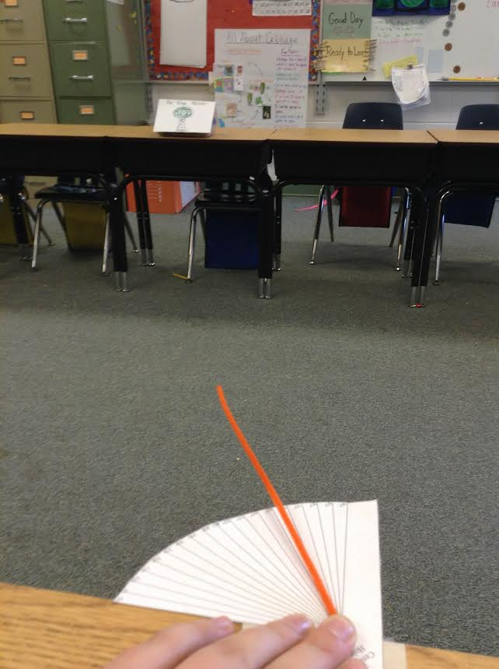
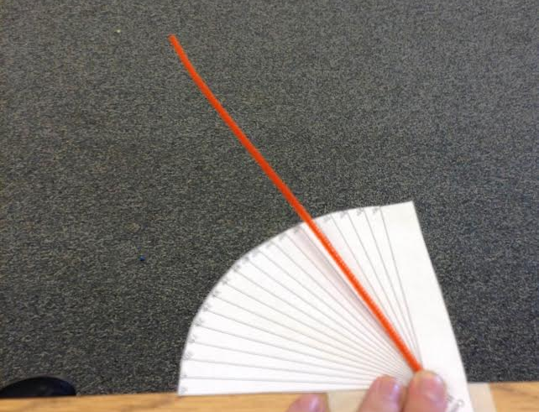
Demonstration
Note: Make sure to have groups of 2 students at each point. One student can get eye level with the pipe cleaner to yield a more accurate angle measurement. Also, print the protractors on cardstock for more stability and ease when measuring.

Slide 8
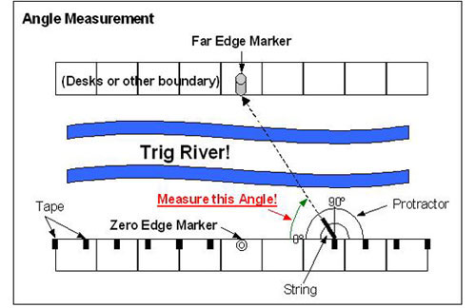
Visual Representation

Slide 9
Procedure:
1. On one side of the river (as close to the middle of that side as possible, set an object that will be the Far Edge Marker. Normally this represents a tree right at the edge of the opposite side of the river.
2. Directly across from the marker, place a Zero Edge Marker (see Figure 1). All the students should be on this side of the river.
3. Lay the measuring tape along the "zero edge bank" with one end at the Zero Edge Marker and place a piece of tape every ½ meter on the river edge of the desks. Repeat this in the other direction (see Figure 1).
4. Give each student a worksheet.
5. Each student should make an estimate of how wide the river is and record it on the back of their worksheet (anywhere on the paper is acceptable).
6. Each group will work from a different tape mark. When both students of a group are at their designated mark and have written on their worksheet the distance their tape is from the Zero Edge Marker, give each group a protractor.

Slide 10
Procedure:
7. Lay the protractor with the center point on the middle of the tape and the zero angle pointing toward the Zero Edge Marker (see Figure 2).
8. One student will hold the protractor in place while the other places one end of the string on the center point of the protractor and aims the other end at the Far Edge Marker. Read the angle the string passes over on the protractor (counting up from zero; this should not be more than 90 degrees), and record it on the worksheet. While the students do this, the teacher can measure the actual distance between the two markers; do not reveal the distance yet.
9. Partners switch jobs and record a second measurement on their worksheet.
10. Complete the worksheet calculations. (Leave the desks and markers in place.)
11. Have students compare their estimate of the river width to the actual measurement. How close was their estimate?

Slide 11
Questions To Ask:
Were students who were closer to the zero marker more or less accurate than those further away?
Answer: Students close to the zero marker should be less accurate because the values of the tangents of angles close to 90º become large quickly and a small error in the angle measurement results in a large distance error. Note that the same problem would be seen as the measured angle approached zero degrees, but a student would have to be infinitely far away for that.
Could this measuring method be used in the wilderness if you did not have a calculator or Trig Tables?
Answer: It is not easy to memorize the tangent values for all angles but one value is very easy to remember: tan(45). Have the students find this value and then explain why they get a simple answer.

Slide 12
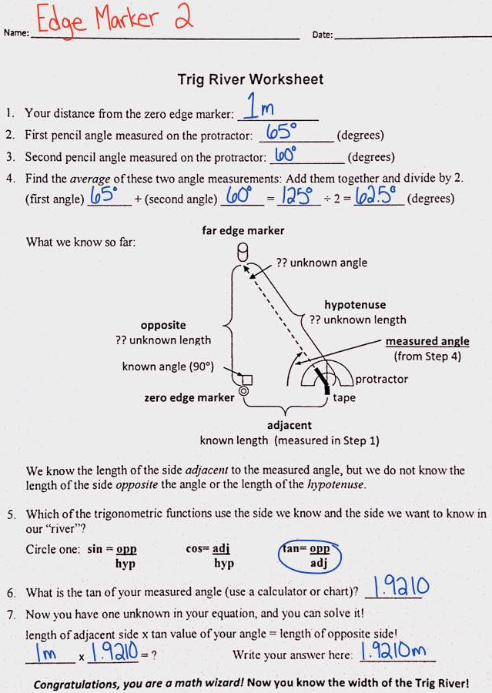
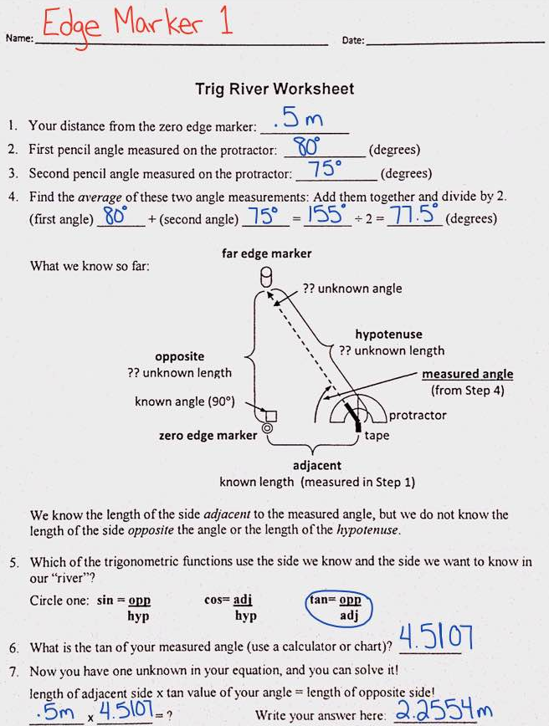
Results
12.77% Error
3.95% Error

Slide 13
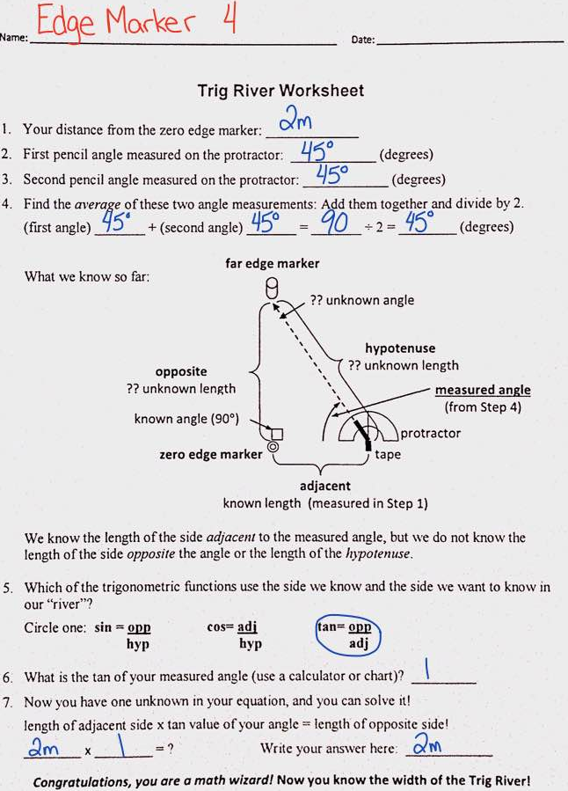
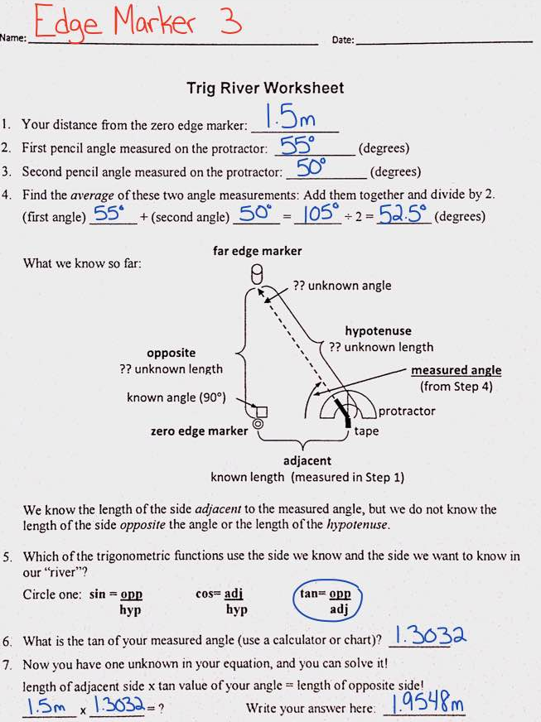
Results:
2.26% Error
0% Error

Slide 14
Sources
TeachEngineering.Org
NYS Common Core Standards

